Slide 1
Document Embedding for Scientific Articles:
A validation of word embeddings
Student | H.J. Meijer
UvA Supervisor | R. Cushing
First Elsevier Supervisor | R. Karimi
Second Elsevier Supervisor | J.A. Schijvenaars

Slide 2
Overview
Introduction
Research objectives
Terminology
Domain
Approach
Results
Conclusions
Future work

Slide 3
Introduction
Word embeddings
Numerical representation of a word
Capture word relatedness
Used in search, recommendation and various NLP tasks

Slide 4
Research Objectives
Determine the quality of word embeddings for scientific articles:
RQ 1: Have word-embeddings a higher accuracy for academic texts than TF-IDF for article classification?
RQ 1.1: Do embedding optimizations increase the performance of word embedding on academic texts for article classification?
RQ 1.2: Can the usage of alternative distance metrics improve the performance of word embedding on academic articles for article classification?
RQ 2: Can word embeddings, combined with PCA-based TSNE, create a two-dimensional plot that preserves journal relatedness?

Slide 5
Terminology
Term Frequency * Inversed Document Frequency
Word occurrence
Vocabulary size
Hash buckets
Feature vectors
Comparison
Evaluation is limited to the task (Schnabel et al. ^{[A]})
Ranking based on vector similarity

Slide 6
Terminology - Ranking
Results for Article A:
0. Journal 10
1. Journal 3
2. Journal 6
3. Journal 1
4. Journal 2
5. …

Slide 7
Terminology – Vector similarity
Similarity
Distance between two vectors
Cosine^{[1]}
^{[1]} Performance of multiple distance metrics can be found in Table 4.1, page 17

Slide 8
Terminology
Average & Median:
Numbers | 0, 1, 5, 9, 50 | 0, 1, 5, 9, 11
Average | 13 | 5.2
Median | 5 | 5

Slide 9
Domain
Article & Journals
Title & abstract
Source journal
Research Data:
~1.4 million articles
~3.8 thousand journals
Generic & Domain-Specific

Slide 10
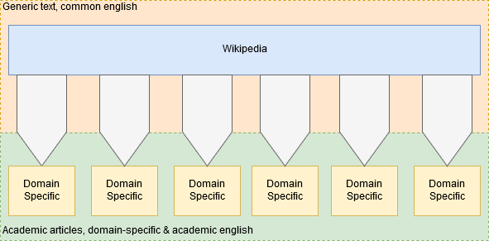
Domain

Slide 11
Approach
Embedding construction:
Word
Pre-trained 300 dimensional
Article
Based on word embeddings
Journal
Based on Article embeddings

Slide 12
Approach
Data splitting:
Training set: 80%
Journal embeddings
Validation set: 20%
Article embeddings
Ranking
Articles to Journals

Slide 13
Approach
Datasets:
Default embedding (embedding)
TF-IDF weighted embedding:
All (tfidf_embedding)
Top 10.000 (10k_embedding)
Top 5.000 (5k_embedding)
Top 1.000 till 6.000 (1k_6k_embedding)
TF-IDF:
10.000 vocabulary size, 10.000 hash bucket size (10K_10K_tfidf)
10.000 vocabulary size, 5.000 hash bucket size (10K_5K_tfidf)
5.000 vocabulary size, 5.000 hash bucket size (5K_5K_tfidf)

Slide 14
Results
Median and average rank performance on title and abstracts
Rank distributions
Memory usage
Two-dimensional plot

Slide 15
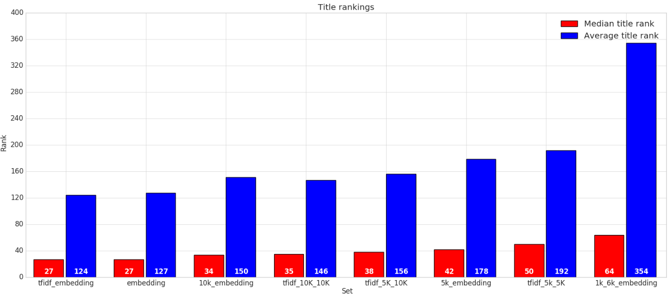
Results – Ranking title

Slide 16
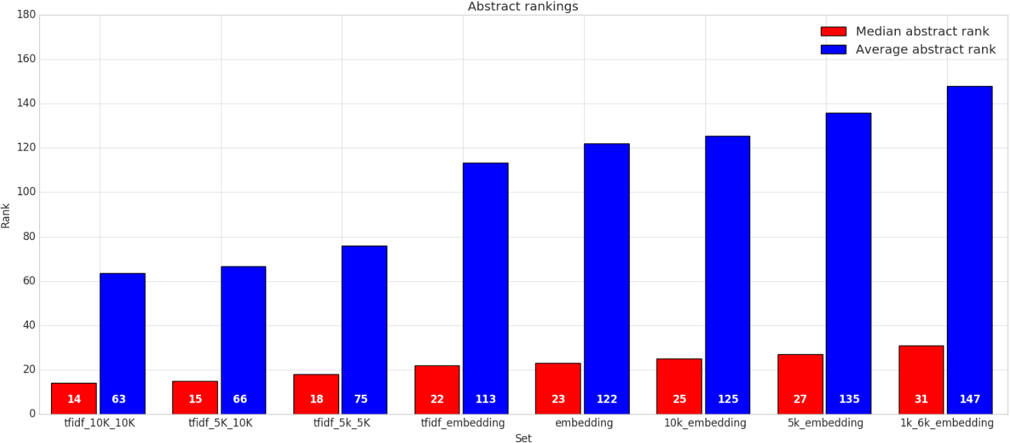
Results – Ranking abstract

Slide 17
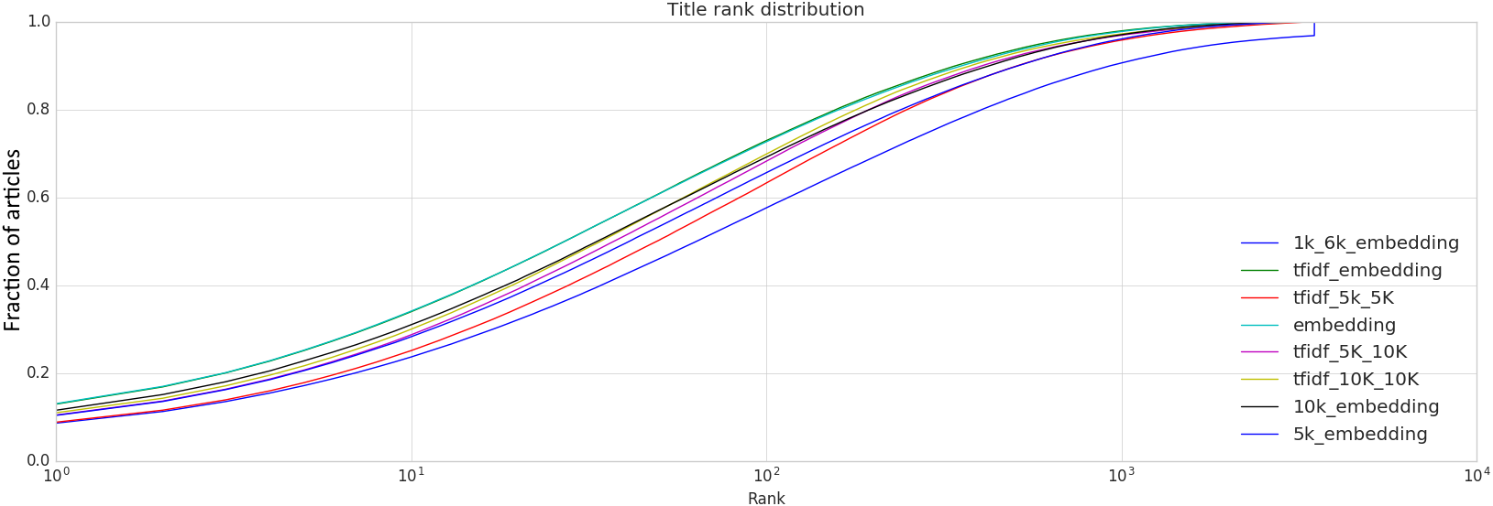
Results – Rank distribution title

Slide 18
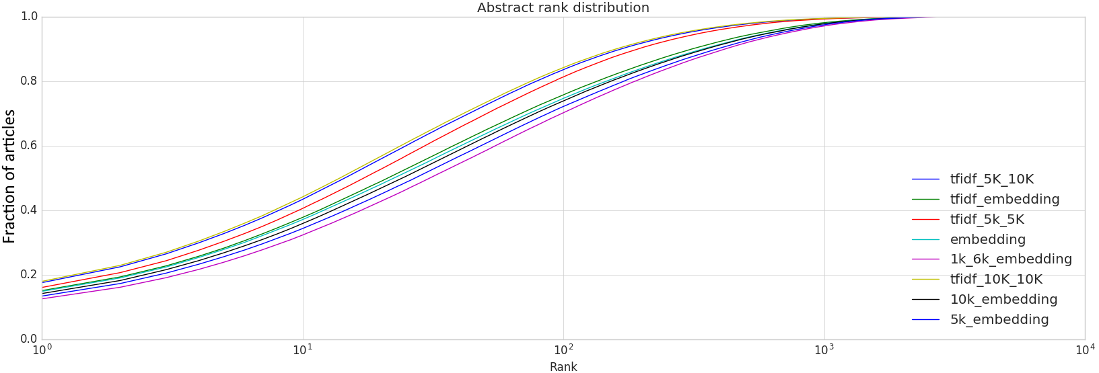
Results – Rank distribution abstract

Slide 19
Memory usage^{[1]}
tfidf 10K 10K: 11.61 GB
Tfidf 5K 5K: 9.82
tfidf embedding: 3.13 GB
1K 6K embedding: 3.06 GB
^{[1]}More statistics can be found in Table 5.1, page 24

Slide 20
Two-dimensional plot
Vector-dimension reduction using TSNE based on PCA
Reducing the 300-dimensional embeddings to a 2-dimensional vector

Slide 21
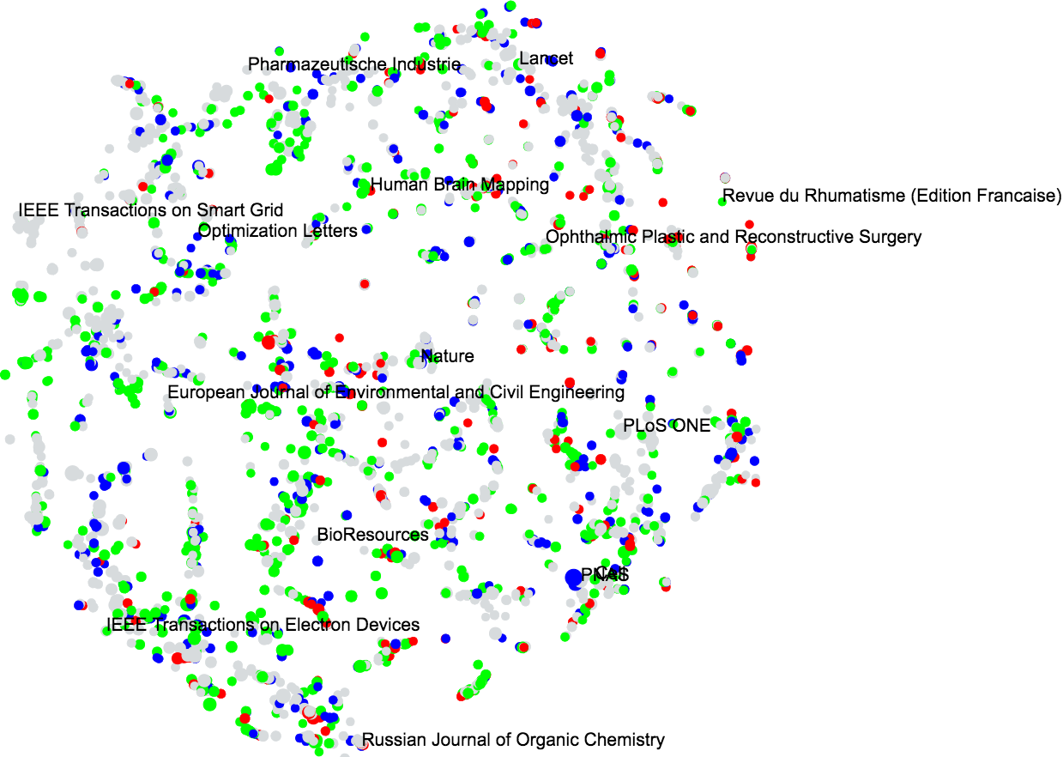
Results – Tittle plot

Slide 22
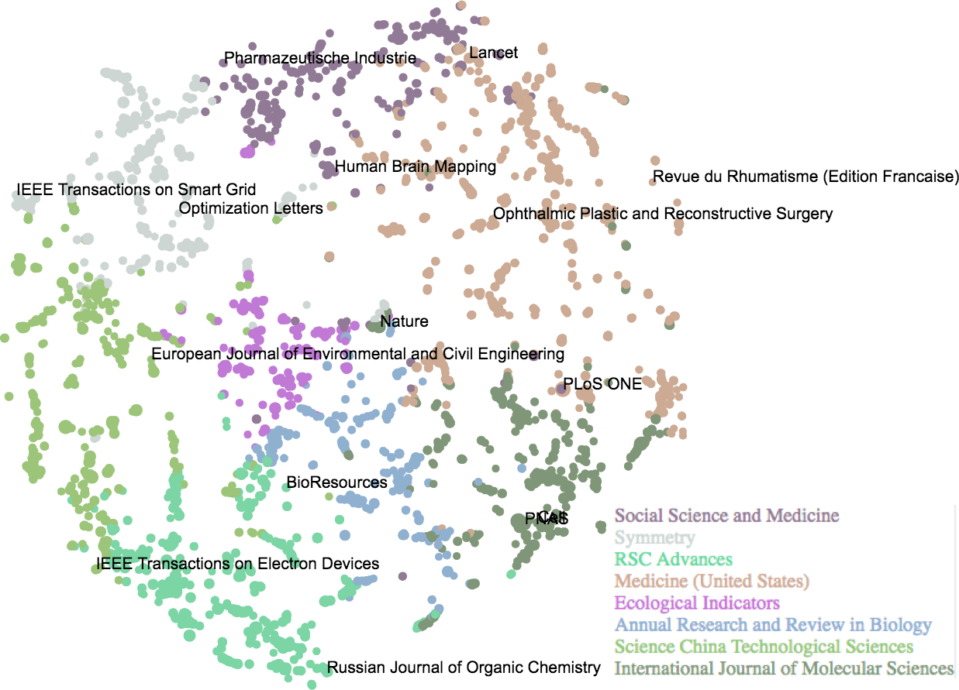
Results – Title plot grouped

Slide 23
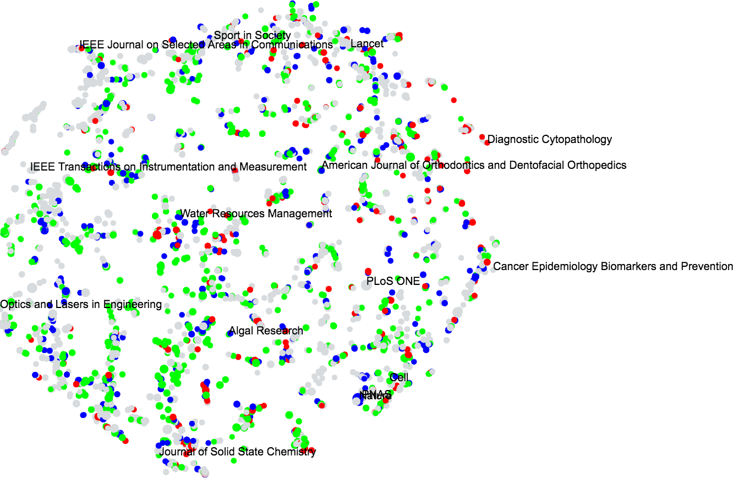
Results – Abstract plot

Slide 24
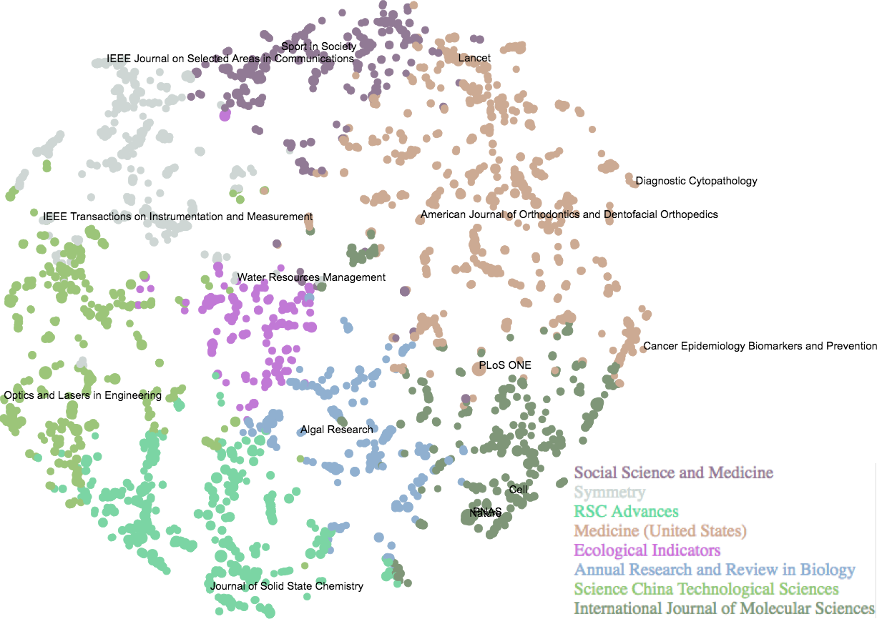
Results – Abstract plot grouped

Slide 25
Conclusions
Article based embeddings perform better than TF-IDF on titles
TF-IDF performs better than article based embeddings on abstracts
Embeddings give a significant decrease in memory usage compared to TF-IDF
Visualization of the journal embeddings show that the embeddings capture and preserve subject relatedness.

Slide 26
Future work
Intelligent cutting
Reducing generic words
TF-IDF & Embedding performance crossing
Where is the point where TF-IDF beats the embeddings?
Pre-categorization
Reducing the problems to embedding domains to reduce ambiguity

Slide 27
Document Embedding for Scientific Articles:
A validation of word embeddings
Research objectives
Approach
Ranking, rank distribution & memory usage
Two dimensional embedding plots
Conclusion & Future work
References:
[A] Tobias Schnabel, Igor Labutov, David Mimno, and Thorsten Joachims. Evaluation methods for unsupervised word embeddings. In Proceedings of the 2015 Conference on Empirical Methods in Natural Language Processing, pages 298–307, 2015.

Slide 28
References
Intelligent cutting
Reducing generic words
TF-IDF & Embedding performance crossing
Where is the point where TF-IDF beats the embeddings?
Pre-categorization
Reducing the problems to embedding domains to reduce ambiguity

Slide 29
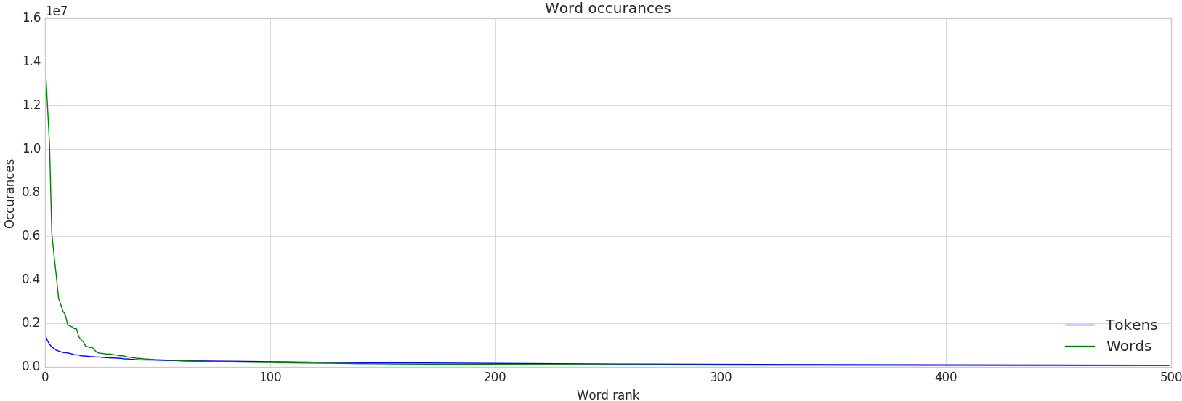
Appendix A: Word & token occurrences

Slide 30
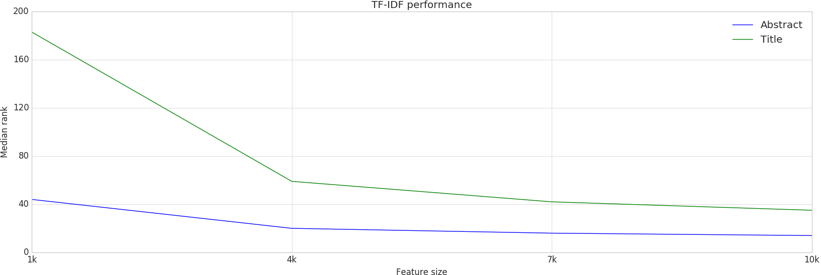
Appendix B : TF-IDF Configurations
(1/2)

Slide 31
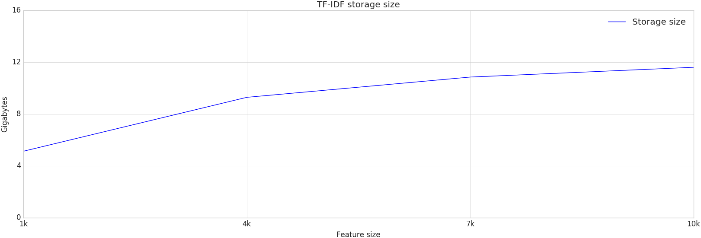
Appendix B : TF-IDF Configurations
(2/2)

